Slide 1
Capstone Project
Used Car Price Prediction model

Slide 2
Problem Statement
This project aims to solve the problem of predicting the price of a used car, using Sklearn's supervised machine learning techniques integrated with Sklearn library. It is clearly a regression problem and predictions are carried out on dataset of used car sales in the American car market. Several regression techniques have been studied, including Linear Regression, Decision Trees and Random forests of decision trees. Their performances were compared in order to determine which one works best with out dataset.

Slide 3
Content
Data Pipeline
Data Description
Exploratory Data Analysis
Models performed
Model Validation & Selection
Evaluation Matrix of All the models
Model Explainability - SHAP
Challenges
Conclusion

Slide 4
Meta Data : UsedCars.csv
Before Feature extraction :
<class 'pandas.core.frame.DataFrame'>
RangeIndex: 4009 entries, 0 to 4008
Data columns (total 13 columns):
# Column Non-Null Count Dtype
--- ------ -------------- -----
0 brand 4009 non-null object
1 model 4009 non-null object
2 model_year 4009 non-null Int64
3 milage 4009 non-null object
4 fuel_type 3839 non-null object
5 engine 4009 non-null object
6 transmission 4009 non-null object
7 ext_col 4009 non-null object
8 int_col 4009 non-null object
9 accident 3896 non-null object
10 clean_title 3413 non-null object
11 price 4009 non-null object
12 condition 0 non-null float64
dtypes: float64(1), int64(1), object(11)
memory usage: 407.3+ KB
After Feature extraction:
<class 'pandas. core. frame. DataFrame'>
RangeIndex: 3964 entries, 0 to 3963
Data columns (total 15 columns):
# Column Non-Null Count Dtype
--- ------ -------------- -----
0 brand 3964 non-null float64
1 model 3964 non-null float64
2 model_year 3964 non-null float64
3 fuel_type 3964 non-null float64
4 ext_col 3964 non-null float64
5 Int_col 3964 non-null float64
6 accident 3964 non-null int32
7 clean_title 3964 non-null float64
8 horsepower 3767 non-null float64
9 Displacement 3771 non-null float64
10 Cylinders 3064 non-null float64
11 Gear 2536 non-null float64
12 Transmission 3964 non-null float64
13 d_in_km 3964 non-null float64
14 Price 3964 non-null int64
dtypes: float64(13), int32(1), int64(1)
memory usage: 449.2 KB

Slide 5
Steps for creating model
Data Collection 📊 - Leveraging the vast repository of Kaggle, we've meticulously gathered our dataset. [Link]
Feature Extraction🔍- Unveiling insights from the engine column, we've extracted a myriad of features crucial for training our model.
Exploratory Data Analysis (EDA)- In this part we have done some EDA on the features to see the trend.
Data Processing- In this part we went through each attributes and encoded the categorical features.
Model Creation- Finally in this part we created the various models. These various models are being analysed and we tried to study various models so as to get the best performing model for our project.

Slide 6
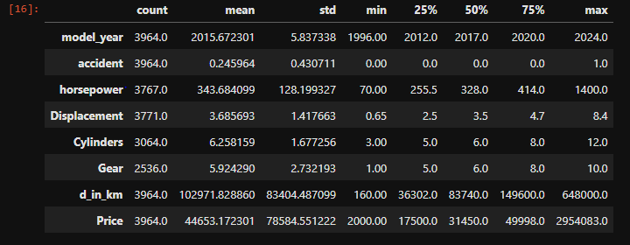
Data Description:

Slide 7
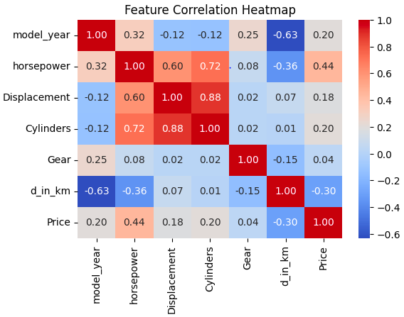
EDA - Feature Correlation

Slide 8
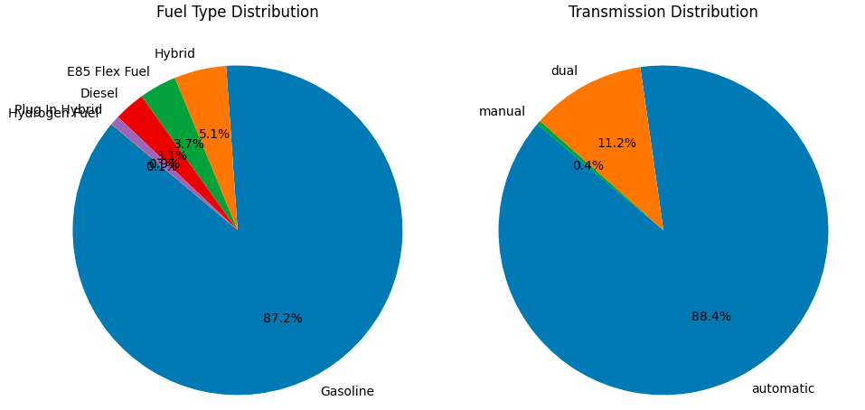
EDA (Pie chart of fuel_type & Transmission)
Gasoline and automatic transmissions are the most prevalent, comprising 87.2% and 88.4% of the total respectively.

Slide 9
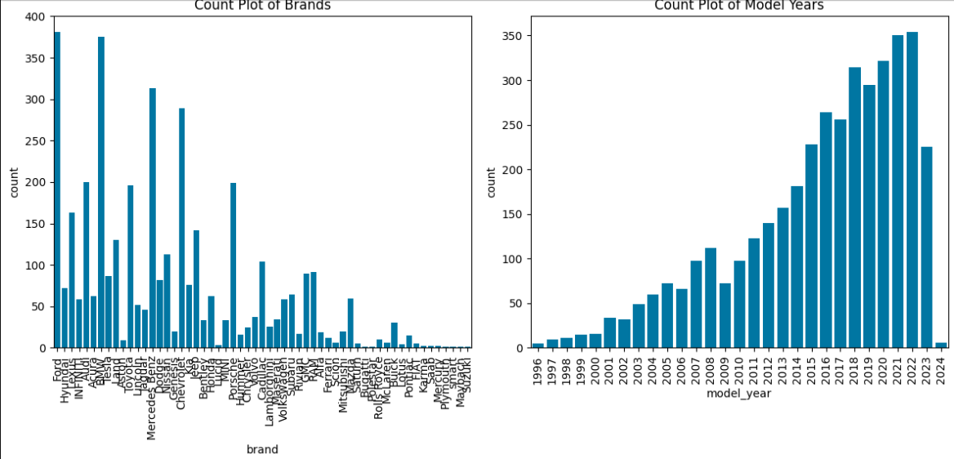
EDA (Brands and Model_year)
We primarily feature Ford and BMW cars in our inventory. Additionally, we offer a wide selection of car models from the years 2021 and 2022

Slide 10
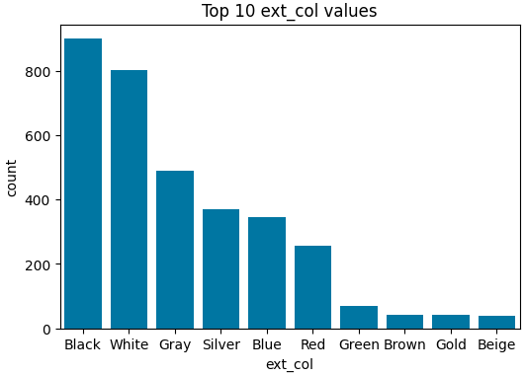
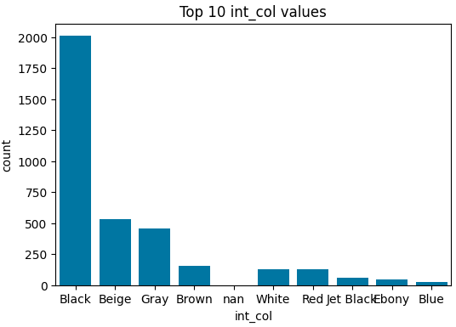
EDA (Top 10 values in int_col, ext_col)

Slide 11
Model’s Performed
Linear Regression with regularizations
Support Vector Machines
Linear SVR
Decision tree
Stochastic Gradient Descent
Decision Tree Regression
Random Forest Regression
AdaBoost Regression
Extra Trees Regressor
Bagging Regressor
Ridge Regressor

Slide 12
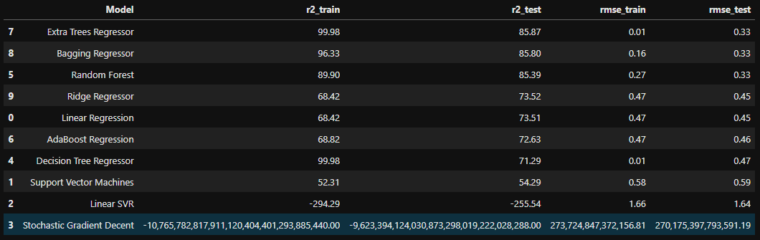
Model’s Evaluation Matrices

Slide 13
Model Validation & Selection(continued)
Observation 1: As seen in the Model Evaluation Matrices table, Linear SVR, Stochastic Gradient Descent is giving worst results.
Observation 2: Extra Trees Regressor & Bagging Regressor have performed equally good in terms of adjusted r2.
Observation 3: We are getting the best results from Random Forest Regression.

Slide 14
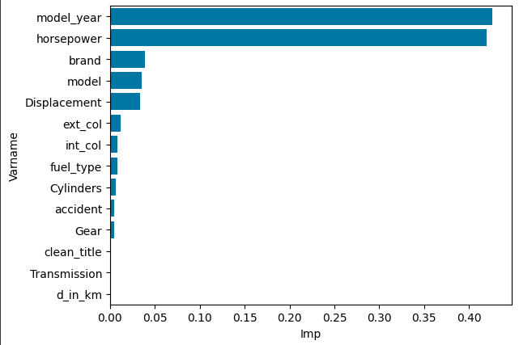
Feature Importance

Slide 15
Challenges
I've encountered several challenges during data extraction, particularly when retrieving information from Google to ensure satisfactory results. Additionally, I've faced difficulties with the extraction feature, especially when dealing with the engine column.
As dataset was quite big enough which led more computation time.
A huge amount of data needed to be dealt while doing the project which is quite an important task and also even small inferences need to be kept in mind.

Slide 16
Conclusion
It is quite evident from the results that Random Forest is the best model that can be used for used car price Prediction since the performance of this model in test is less as compare to train but it best describe the Price of cars.
So, we can use either Random Forest Regressor model for the above problem

Slide 17
THANK
YOU

